Slide 1
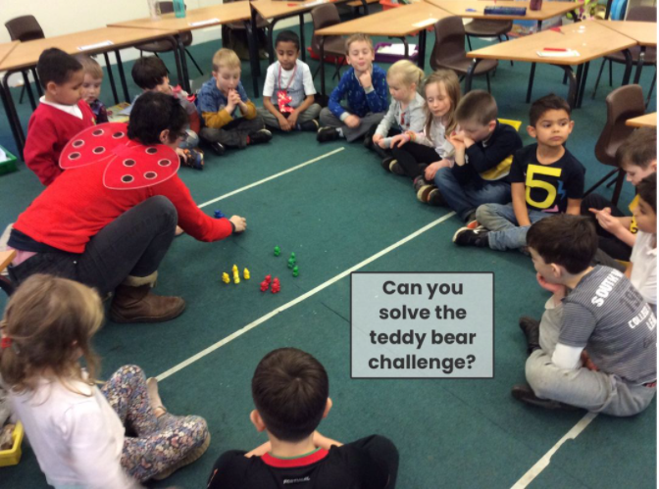
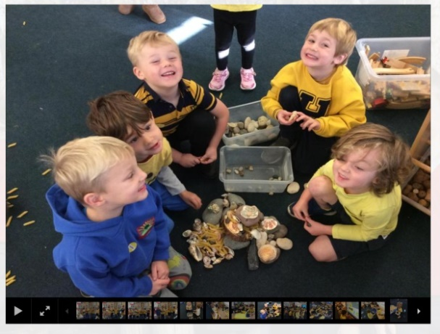
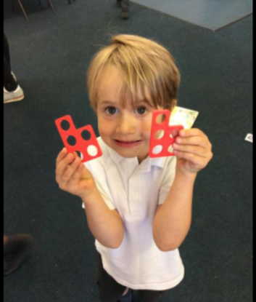
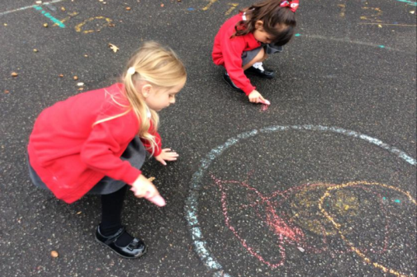
Maths in the Early Years (and beyond!) at New Scotland Hill Primary School And Nursery
EYFS Lead: Sandeep Dhariwal sdhariwal@nshprimary.co.uk
Maths Standards Lead: Anneke Robinson
arobinson@nshprimary.co.uk

Slide 2
A big change
New framework sees changes to maths:
Developing a strong grounding in number – a building block to further maths.
Developing a deep understanding of the numbers to 10.
Developing spacial and reasoning skills across the year.
Developing positive attitudes to maths

Slide 3
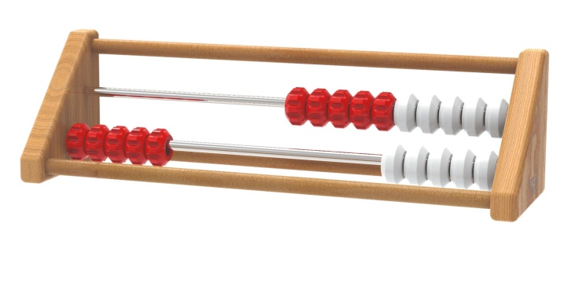
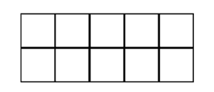
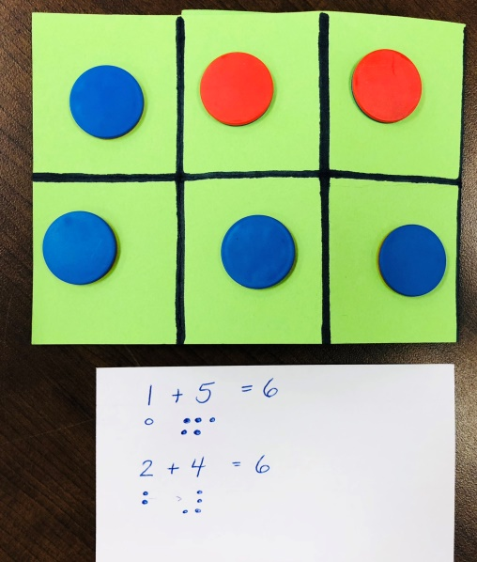
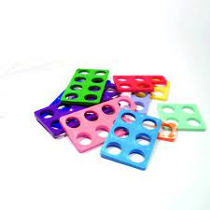
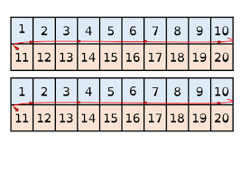
Number
A strong grounding in number.
A deep understanding of the numbers 1 to 10.
Mastering number or Number Sense: 15 minutes a day – following a programme by The National Centre For Excellence In Teaching Mathematics (NCETM). https://vimeo.com/551982402

Slide 4
The Counting Principles
The One-One Principle
The Stable-Order Principle
The Cardinal Principle
The Abstraction Principle
The Order-Irrelevance Principle

Slide 6
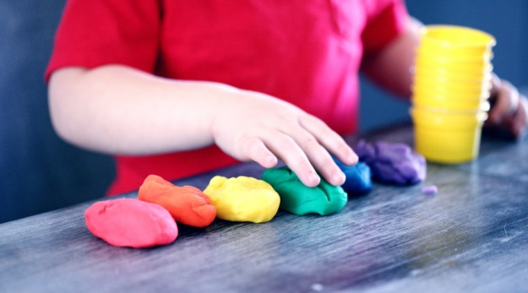
Spacial Reasoning
Spacial reasoning is an understanding of how things (including ourselves) move and interact in relation to the physical space around them.
There is an increasing body of research supporting the importance of early spacial reasoning in predicting later and wider mathematical achievement.
Further reading and ideas of games to play at home: https://www.famly.co/blog/helen-williams-spatial-reasoning

Slide 7
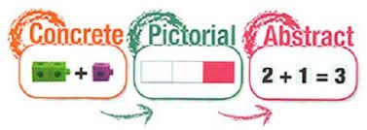
How we teach these concepts
We use a mastery approach which focuses on the Concrete, Pictorial, and Abstract representations in maths (CPA).
Concrete: Your manipulatives/ resources that you can hold and move with your hands that represent the structure of the maths
Pictorial: Diagrams to show the structures of the maths.
Abstract: The written methods use to represent the maths.

Slide 8
White Rose Maths
The Scheme Of Learning the children will follow is White Rose Maths (which is used throughout the school). This will mean that children are immersed in the same representations in maths lessons throughout their school journey.

Slide 9
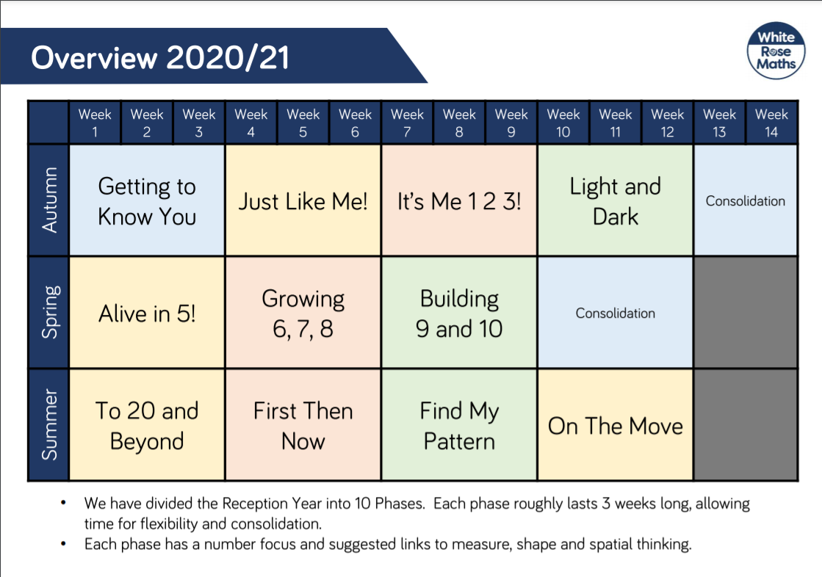

Slide 12
“That’s not how I learnt to do it at school.”
Us neither! Maths has changed hugely since we were in school – even the teachers are having to learn how to teach with mastery in mind.
When we learn by memorising a formula, we can get the correct answer, but often struggle to apply the maths in real life situations. The mastery approach aims to support children in applying the maths in different situations.
We promise there will be moments where you wonder, “Why haven’t they taught her the bus stop method yet?” or think, “My teacher taught me to divide by the bottom and times by the top and I could do it.” However, there are reasons we teach the children how to partition for division in Year 4 before moving onto the bus stop method in Year 5 (so they can divide efficiently without depending on written methods unless required) or to find the part of the fraction (the denominator) using a bar model before multiplying it – so they understand what their answer means.
If you have any concerns (throughout your child’s school career) please get in touch with the class teacher – who will be happy to explain the thinking behind the way the maths is being taught, or the way in which you can help support your child at home.

Slide 13
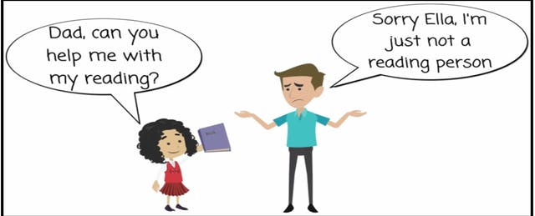
“I wasn’t good at maths at school, either.”
Please never say this to your child.
It suggests to them that some people are ‘just good at maths’. Through a mastery approach, every child should be able to access the maths they are being taught, with understanding. No one is a born mathematician – their previous experiences with maths will play a major role in their ability to access the maths being taught and our teachers are there to go at your child’s pace and support them where they are.

Slide 14
“My child can already count to 100.”
If your child is able to count above 20 (the children count to 20 in Reception) we will support them by encouraging them to go ‘deeper’ rather than ‘higher’. This will be through pattern spotting, understanding the relationships between the numbers to 10, applying their understanding in other situations, looking for number neighbours, using subtraction and addition interchangeable and discussing their understanding of the maths, as examples.
We won’t stretch them by encouraging them to count higher, instead they will be challenged within the curriculum content for their year group.

Slide 15
How can you help us?
Play games with your children:
Bunny ears, Kim’s game, counting games, board games, card games, treasure hunts – you name it, these all help with your child’s mathematical development.

Slide 16
Any Questions?
We hope you have found this presentation useful.
If you would like more information please feel free to contact your child’s teacher or Mrs. Robinson (Maths Lead).
arobinson@nshprimary.co.uk
sdhariwal@nshprimary.co.uk

